Slide 1
Spring

Slide 2
At 7:50, I Come into classroom 605, open computer, turn on light.
7:55, zhangsan, lisi and other students come into this classroom, find faverivate seat and sit down.
At 8:00, the bell rings, and I begin to explain the DI pattern.

Slide 3
Spring框架就是一个工厂模式的应用。

Slide 4
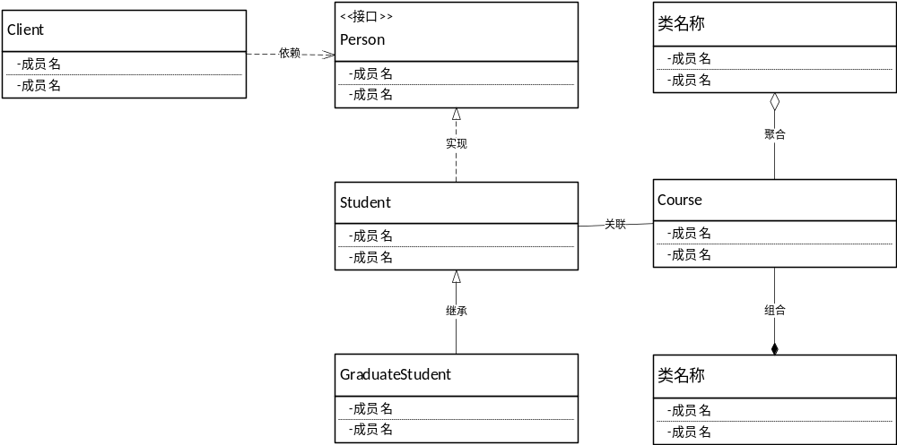
类之间的几种基本关系

Slide 5
DI、IOC模式-编程思想的转变
IoC——Inversion of Control 控制反转
DI——Dependency Injection 依赖注入
板书例子

Slide 6
反射模式
类->对象
Class->类
板书UML图

Slide 7
public static void main(String[] args) throws ClassNotFoundException, InstantiationException, IllegalAccessException {
Class c = Class.forName("copyClassPath2Directory.Student");
Student student=(Student) c.newInstance();
student.setName("梁早清");
System.out.println(student.getName());
}

